Slide 1
Sport Wear Group Analytics Project
Data Scientist
Ali Elsharawy

Slide 2
Agenda
01. Business overview
02. Business Objective
03. Advanced Analytics
04. Data Science Process
05. What’s next

Slide 3

Business Overview
Sports Wear Group is one of the leading retailer's industry in the region, with more than 50 branches across the region.
It runs multiple lines of business applications, mainly in the sport goods industry.
They are in the middle of their digital transformation journey, and they want to keep leading the market by satisfying their customers and meeting their expectation.
January 2, 2024

Slide 4
Business Objective
The Business Objective is to use advanced analytics to increase their sports wear sales and to increase the efficiency of their marketing campaigns.
January 2, 2024

Slide 5
Current Solution
The company is depending on the marketing campaigns to increase sales without using advanced analytics to analyze customer behaviors and patterns.
The advertisements result after presenting the offers to 100k customer have 13.9% success rate.
January 2, 2024

Slide 6
Advanced Analytics
January 2, 2024

Slide 7
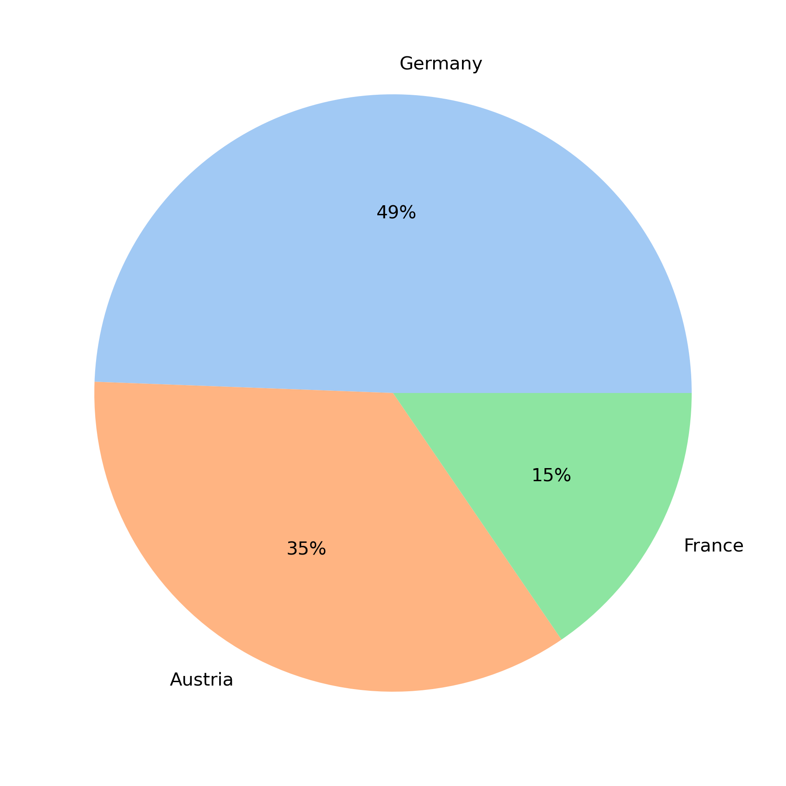
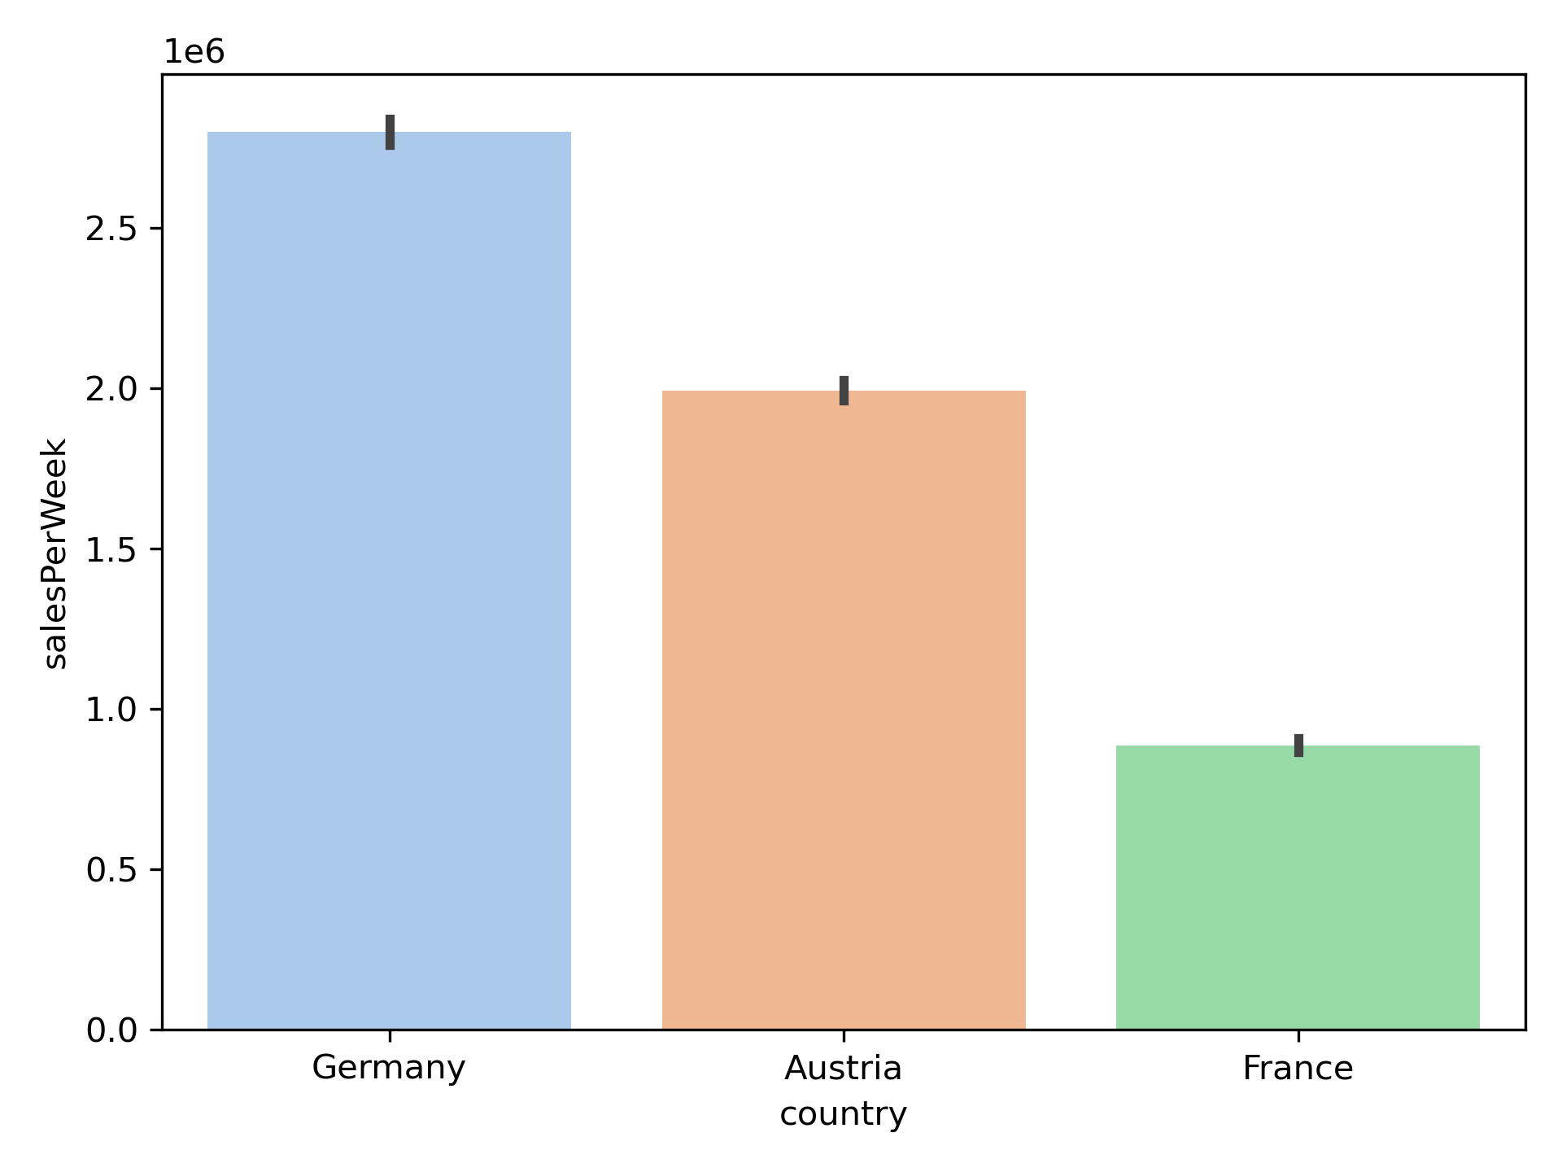
Advanced Analytics
Conclusion:
The Country with the highest Sales is Germany, followed by Austria and France.
Take in mind that the data is imbalanced toward Germany.
January 2, 2024

Slide 8
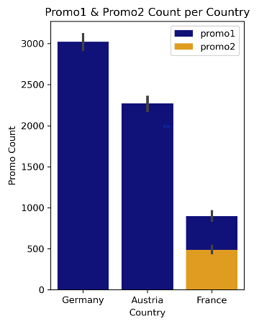
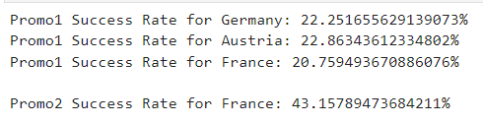
Advanced Analytics
Conclusion:
Promo1 had been launched in all countries, Promo2 had been launched only in France.
There is a relationship between sales and number of promos.
While promo1 has approximately the same success rate in all countries.
Promo2 had twice the success rate in France.
January 2, 2024

Slide 9
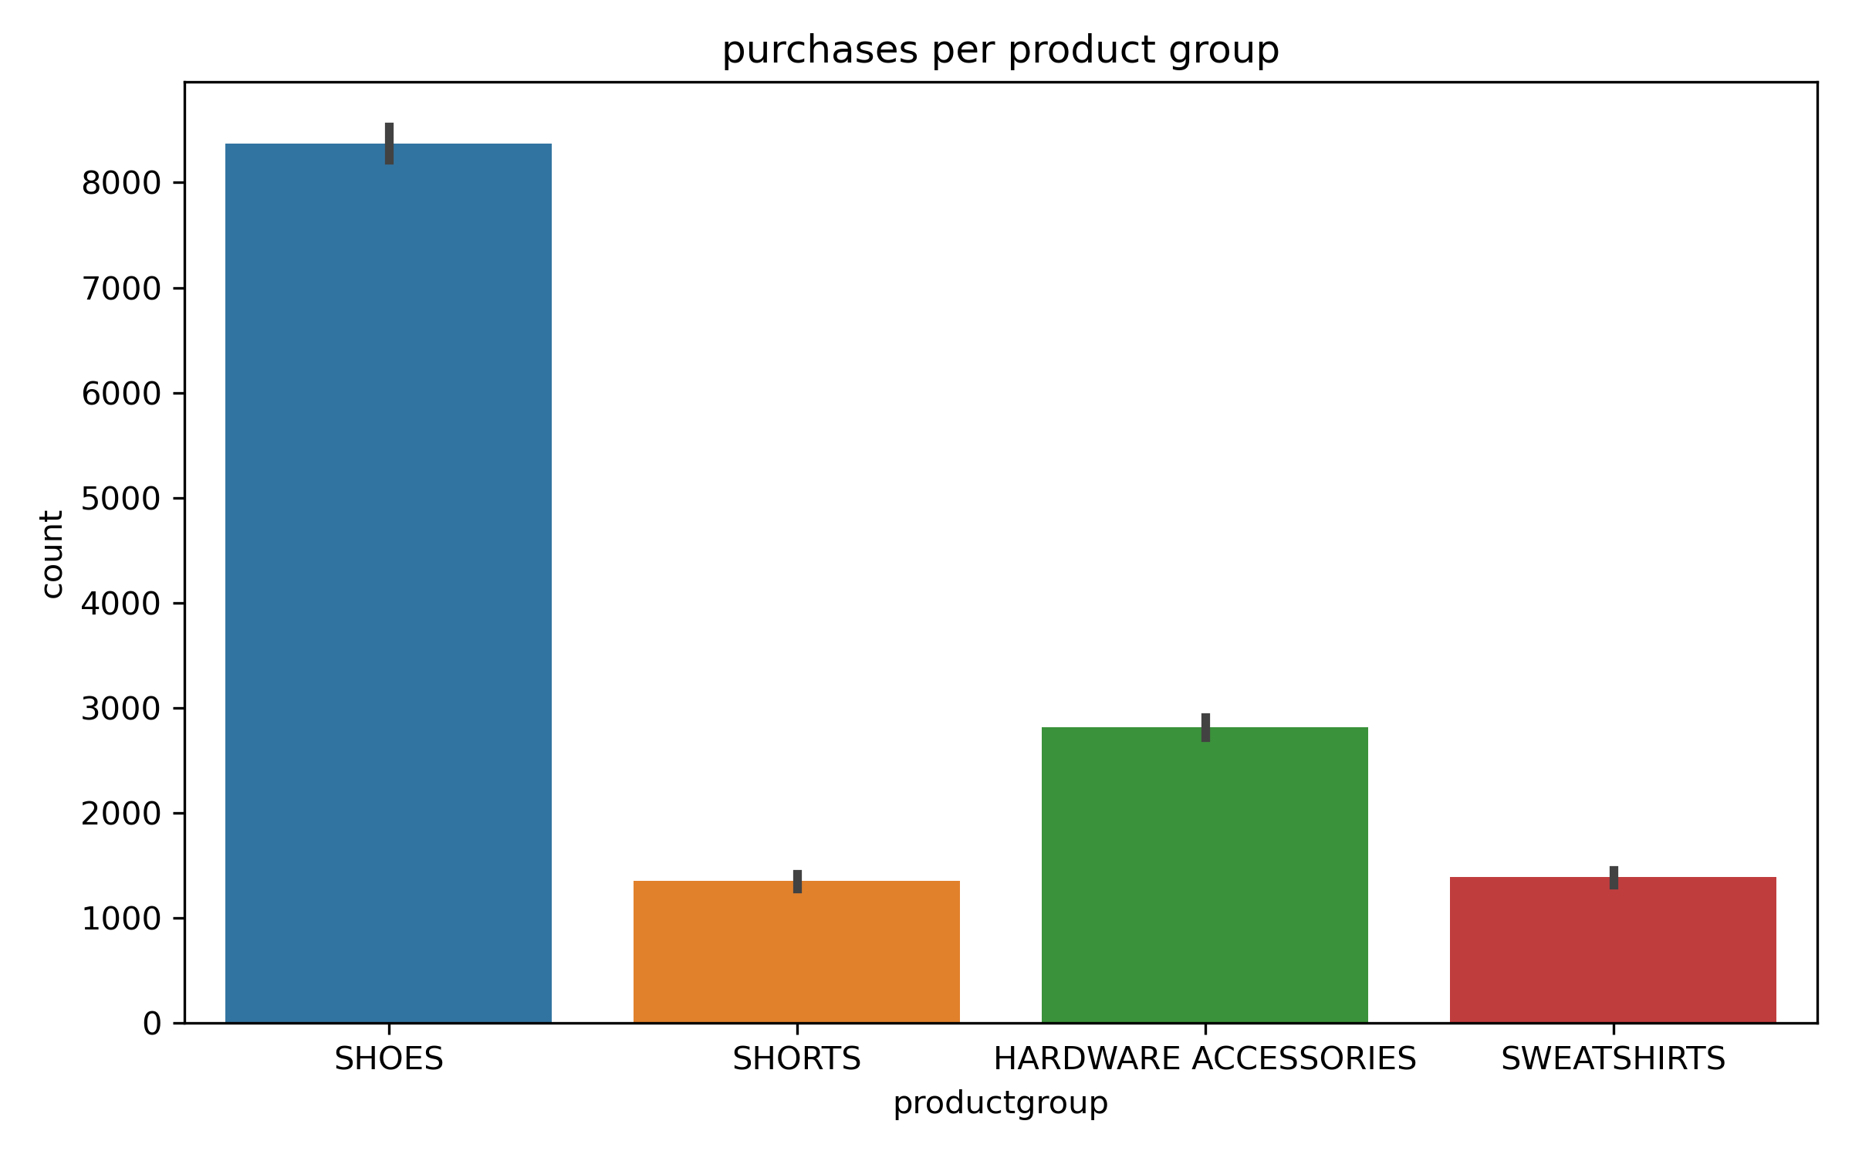
Advanced Analytics
Conclusion:
The most purchased items are:
1- Shoes
2- Hardware Accessories
3- Sweatshirts
4- Shorts
January 2, 2024

Slide 10
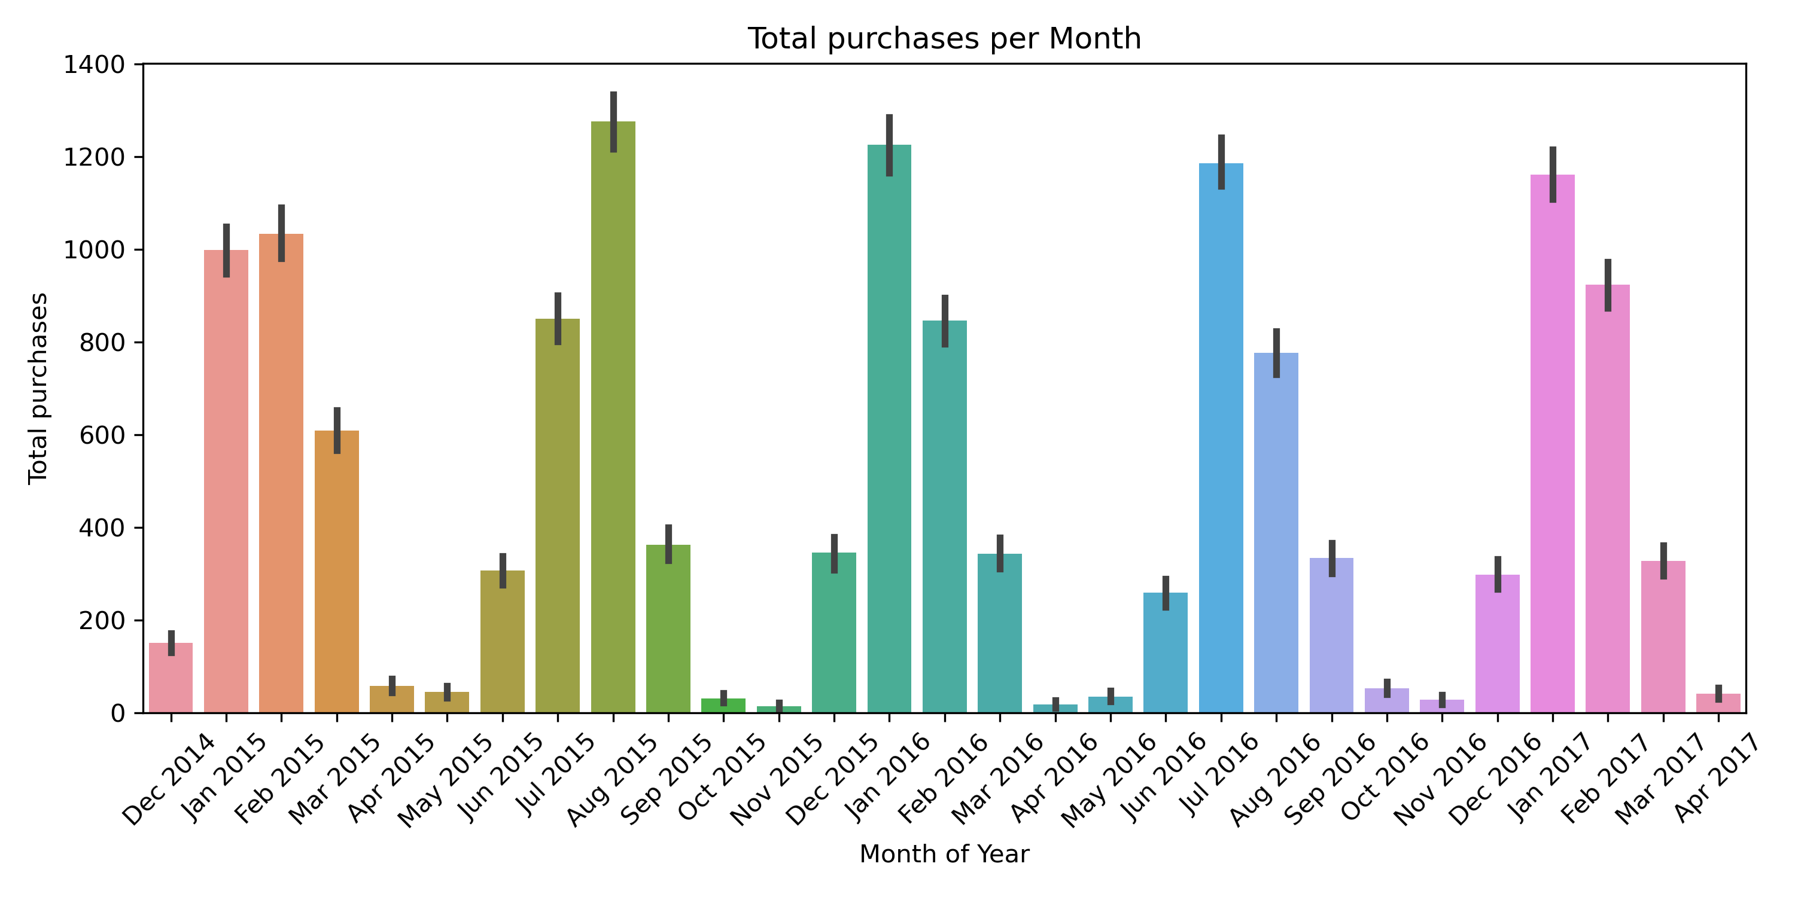
Advanced Analytics
Conclusion:
The month with the Highest purchases is
Aug 2015
It is noted that sales have a sharp decline in April, May, September, October.
So, It is Recommended to launch media advertisements or store events in these months to increase the amount of sales
January 2, 2024

Slide 11
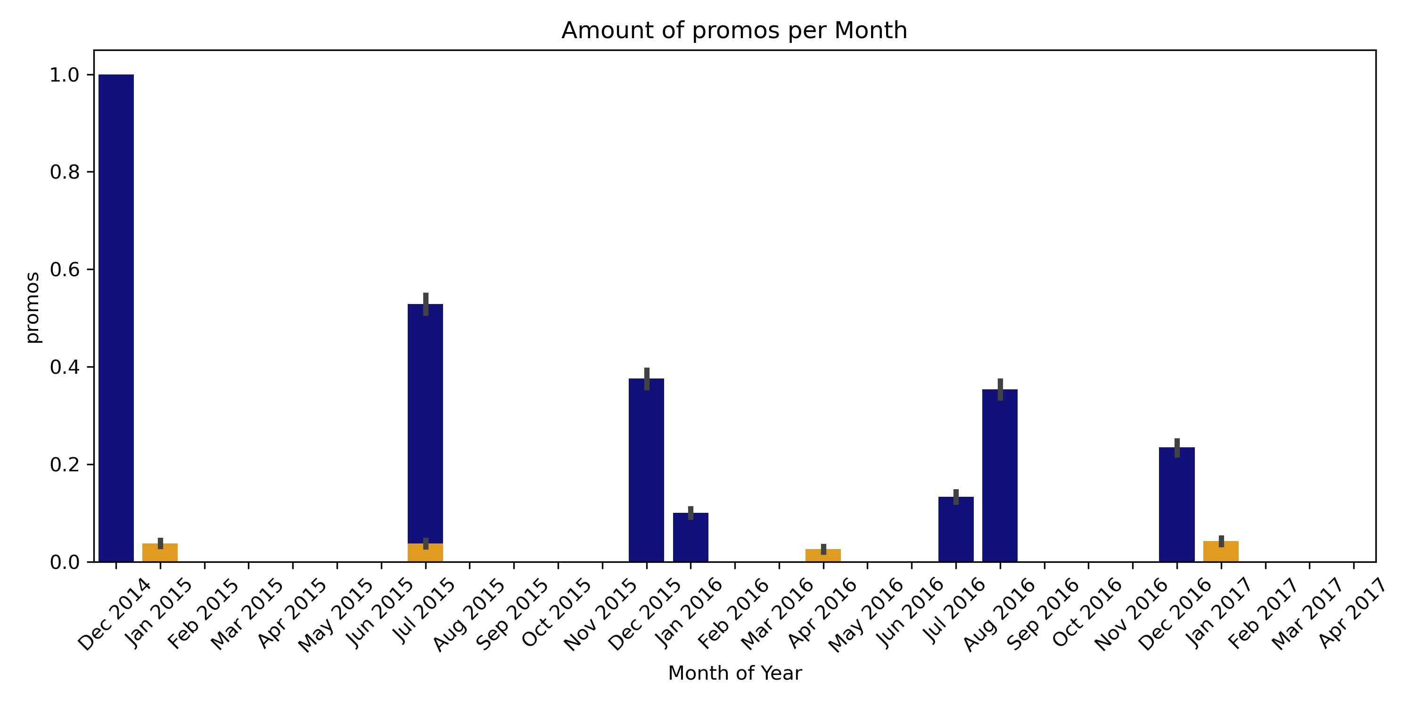
Advanced Analytics
Conclusion:
The promos that happen mostly in December and slightly in January, increase the purchases in both January and February
The promos that happens in July and August, increase the purchases in these months significantly
So, promos take about a month or less to impact sales.
January 2, 2024

Slide 12
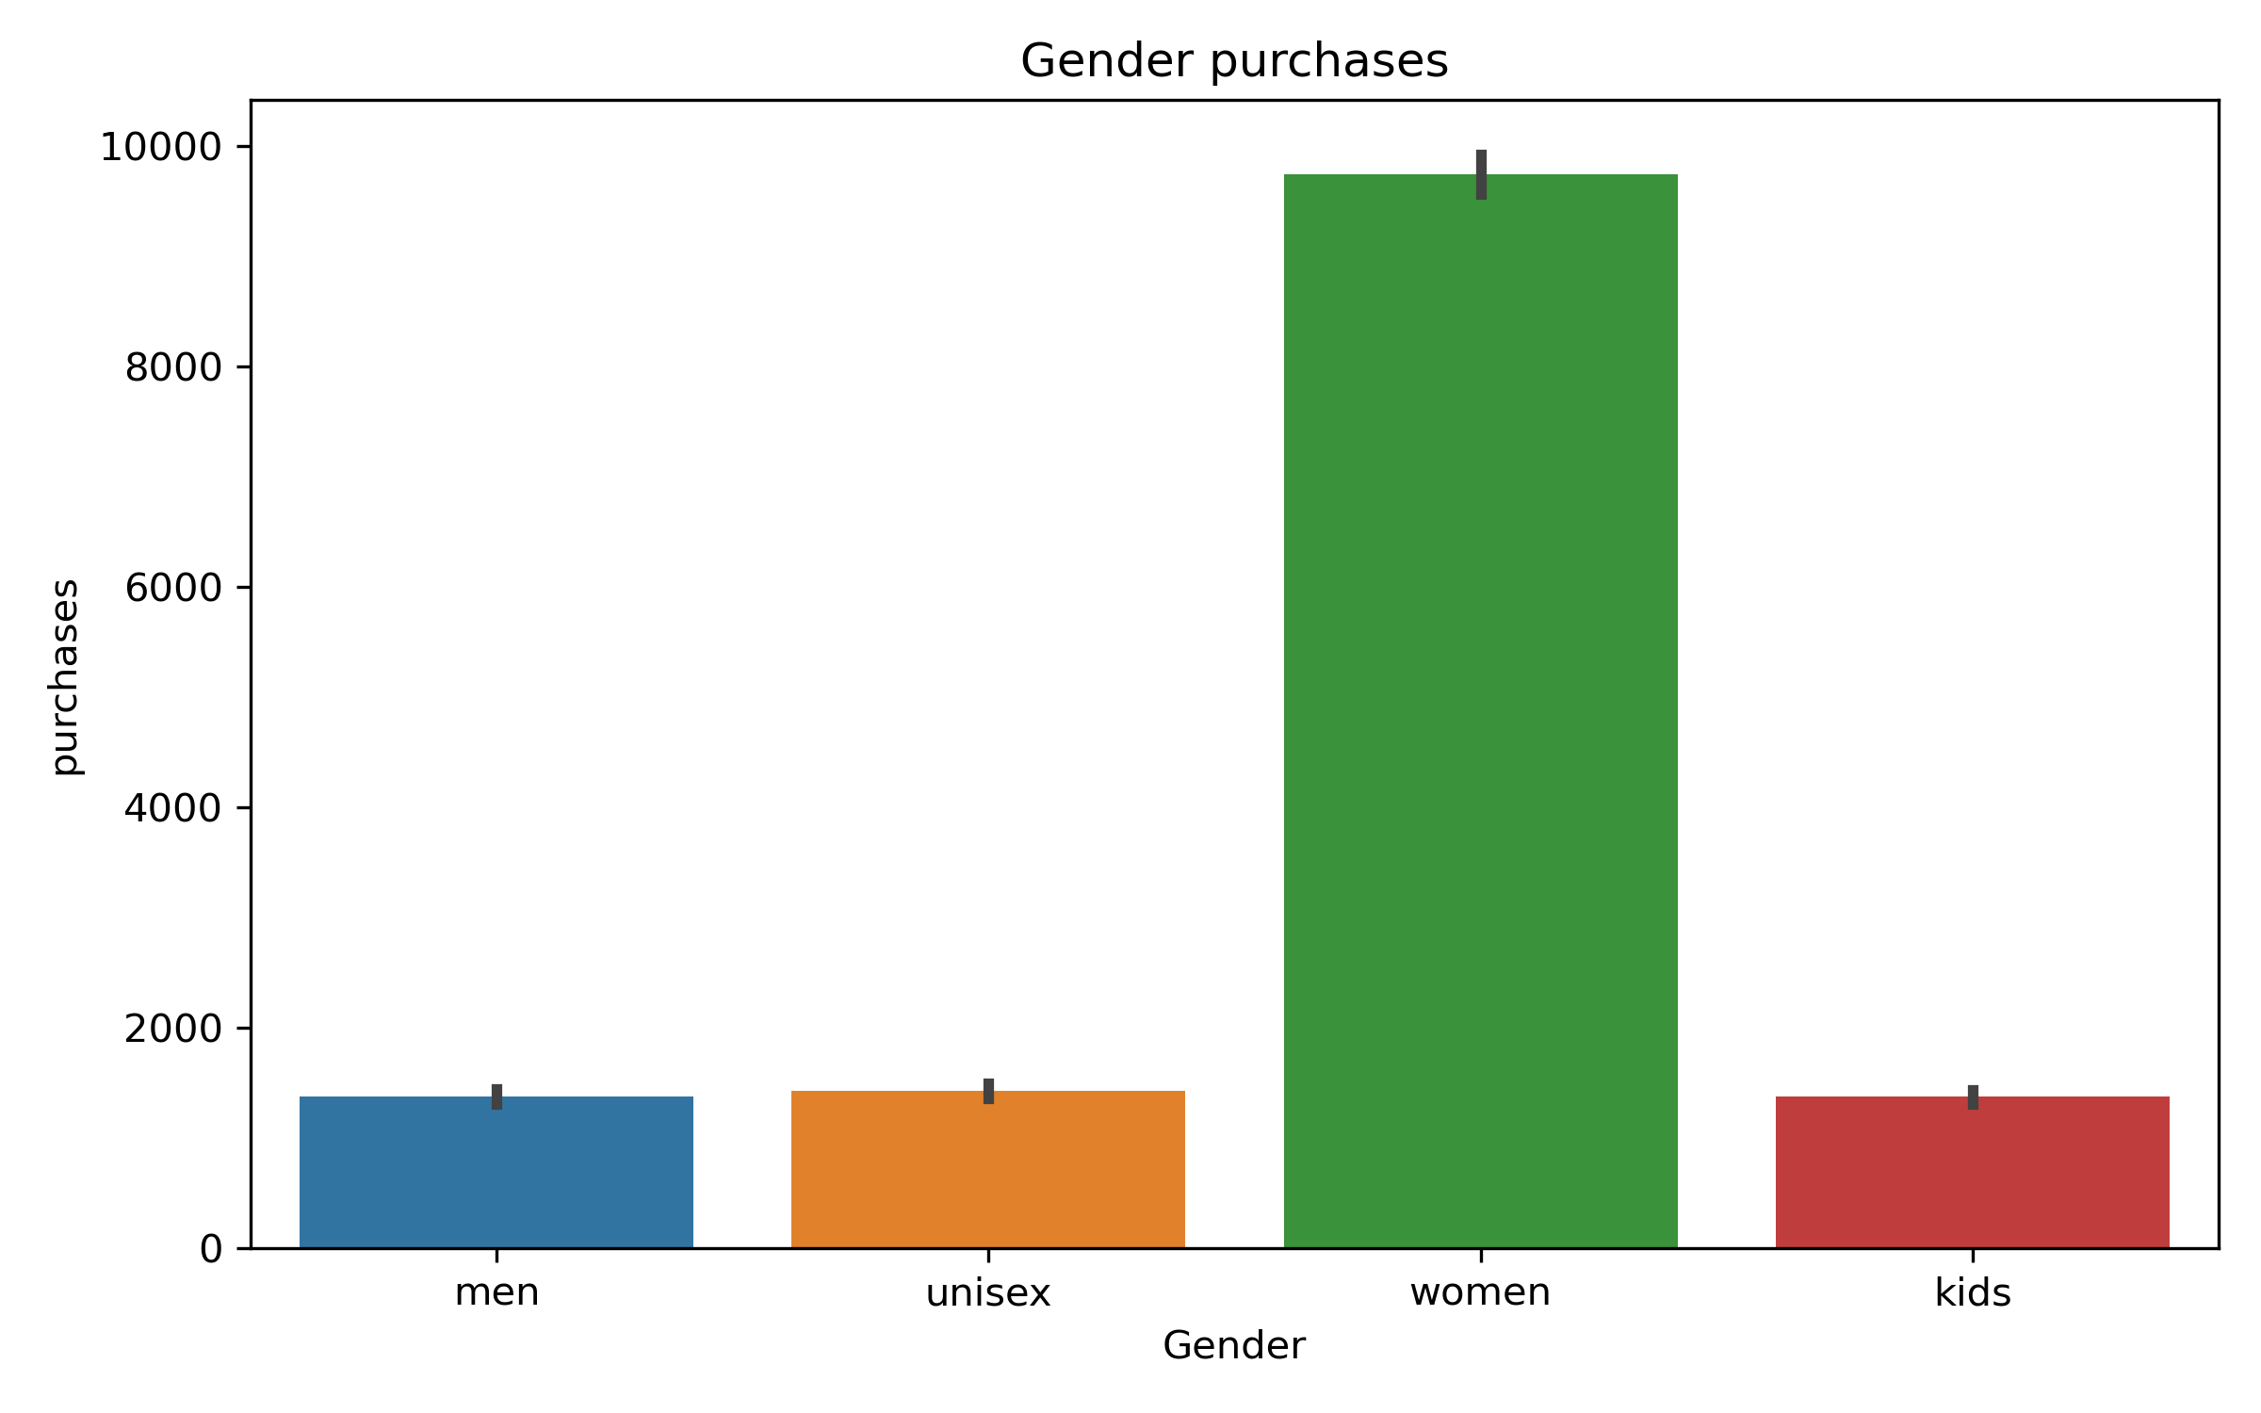
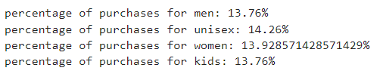
Advanced Analytics
Conclusion:
Despite, Women having the highest number of purchases in the gender category.
The percentage of purchases done in each category is approximately close.
January 2, 2024

Slide 13
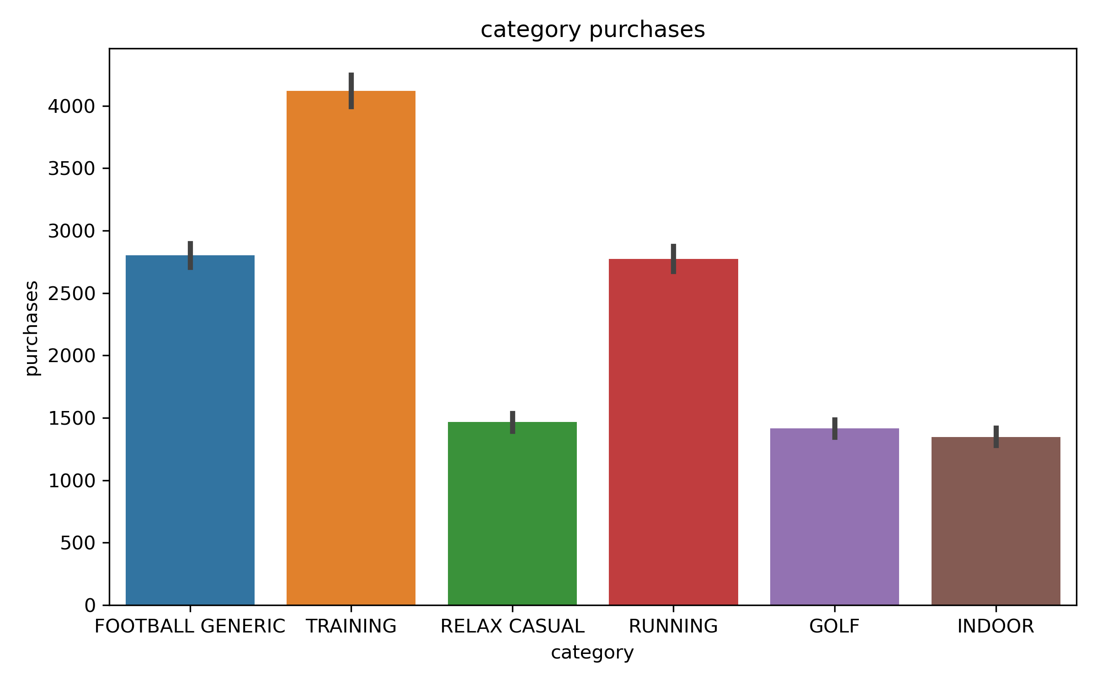
Advanced Analytics
Conclusion:
Training category has the highest number of purchases, followed by Football Generic, Running.
January 2, 2024

Slide 14
Advanced Analytics
Conclusion:
Training category has the highest number of purchases, followed by Football Generic, Running.
January 2, 2024

Slide 15
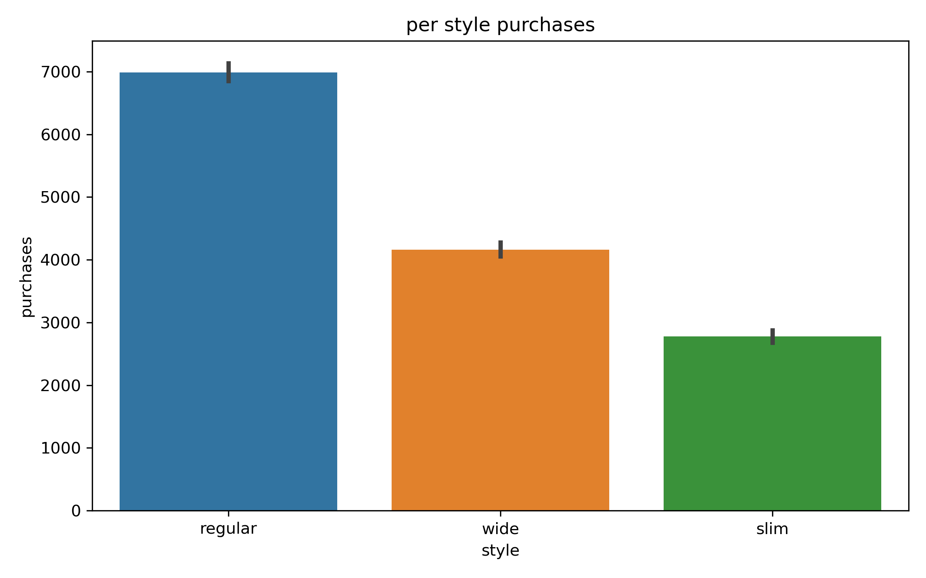
Advanced Analytics
Conclusion:
The Most Purchases is done in regular size, followed by wide and slim sizes.
January 2, 2024

Slide 16
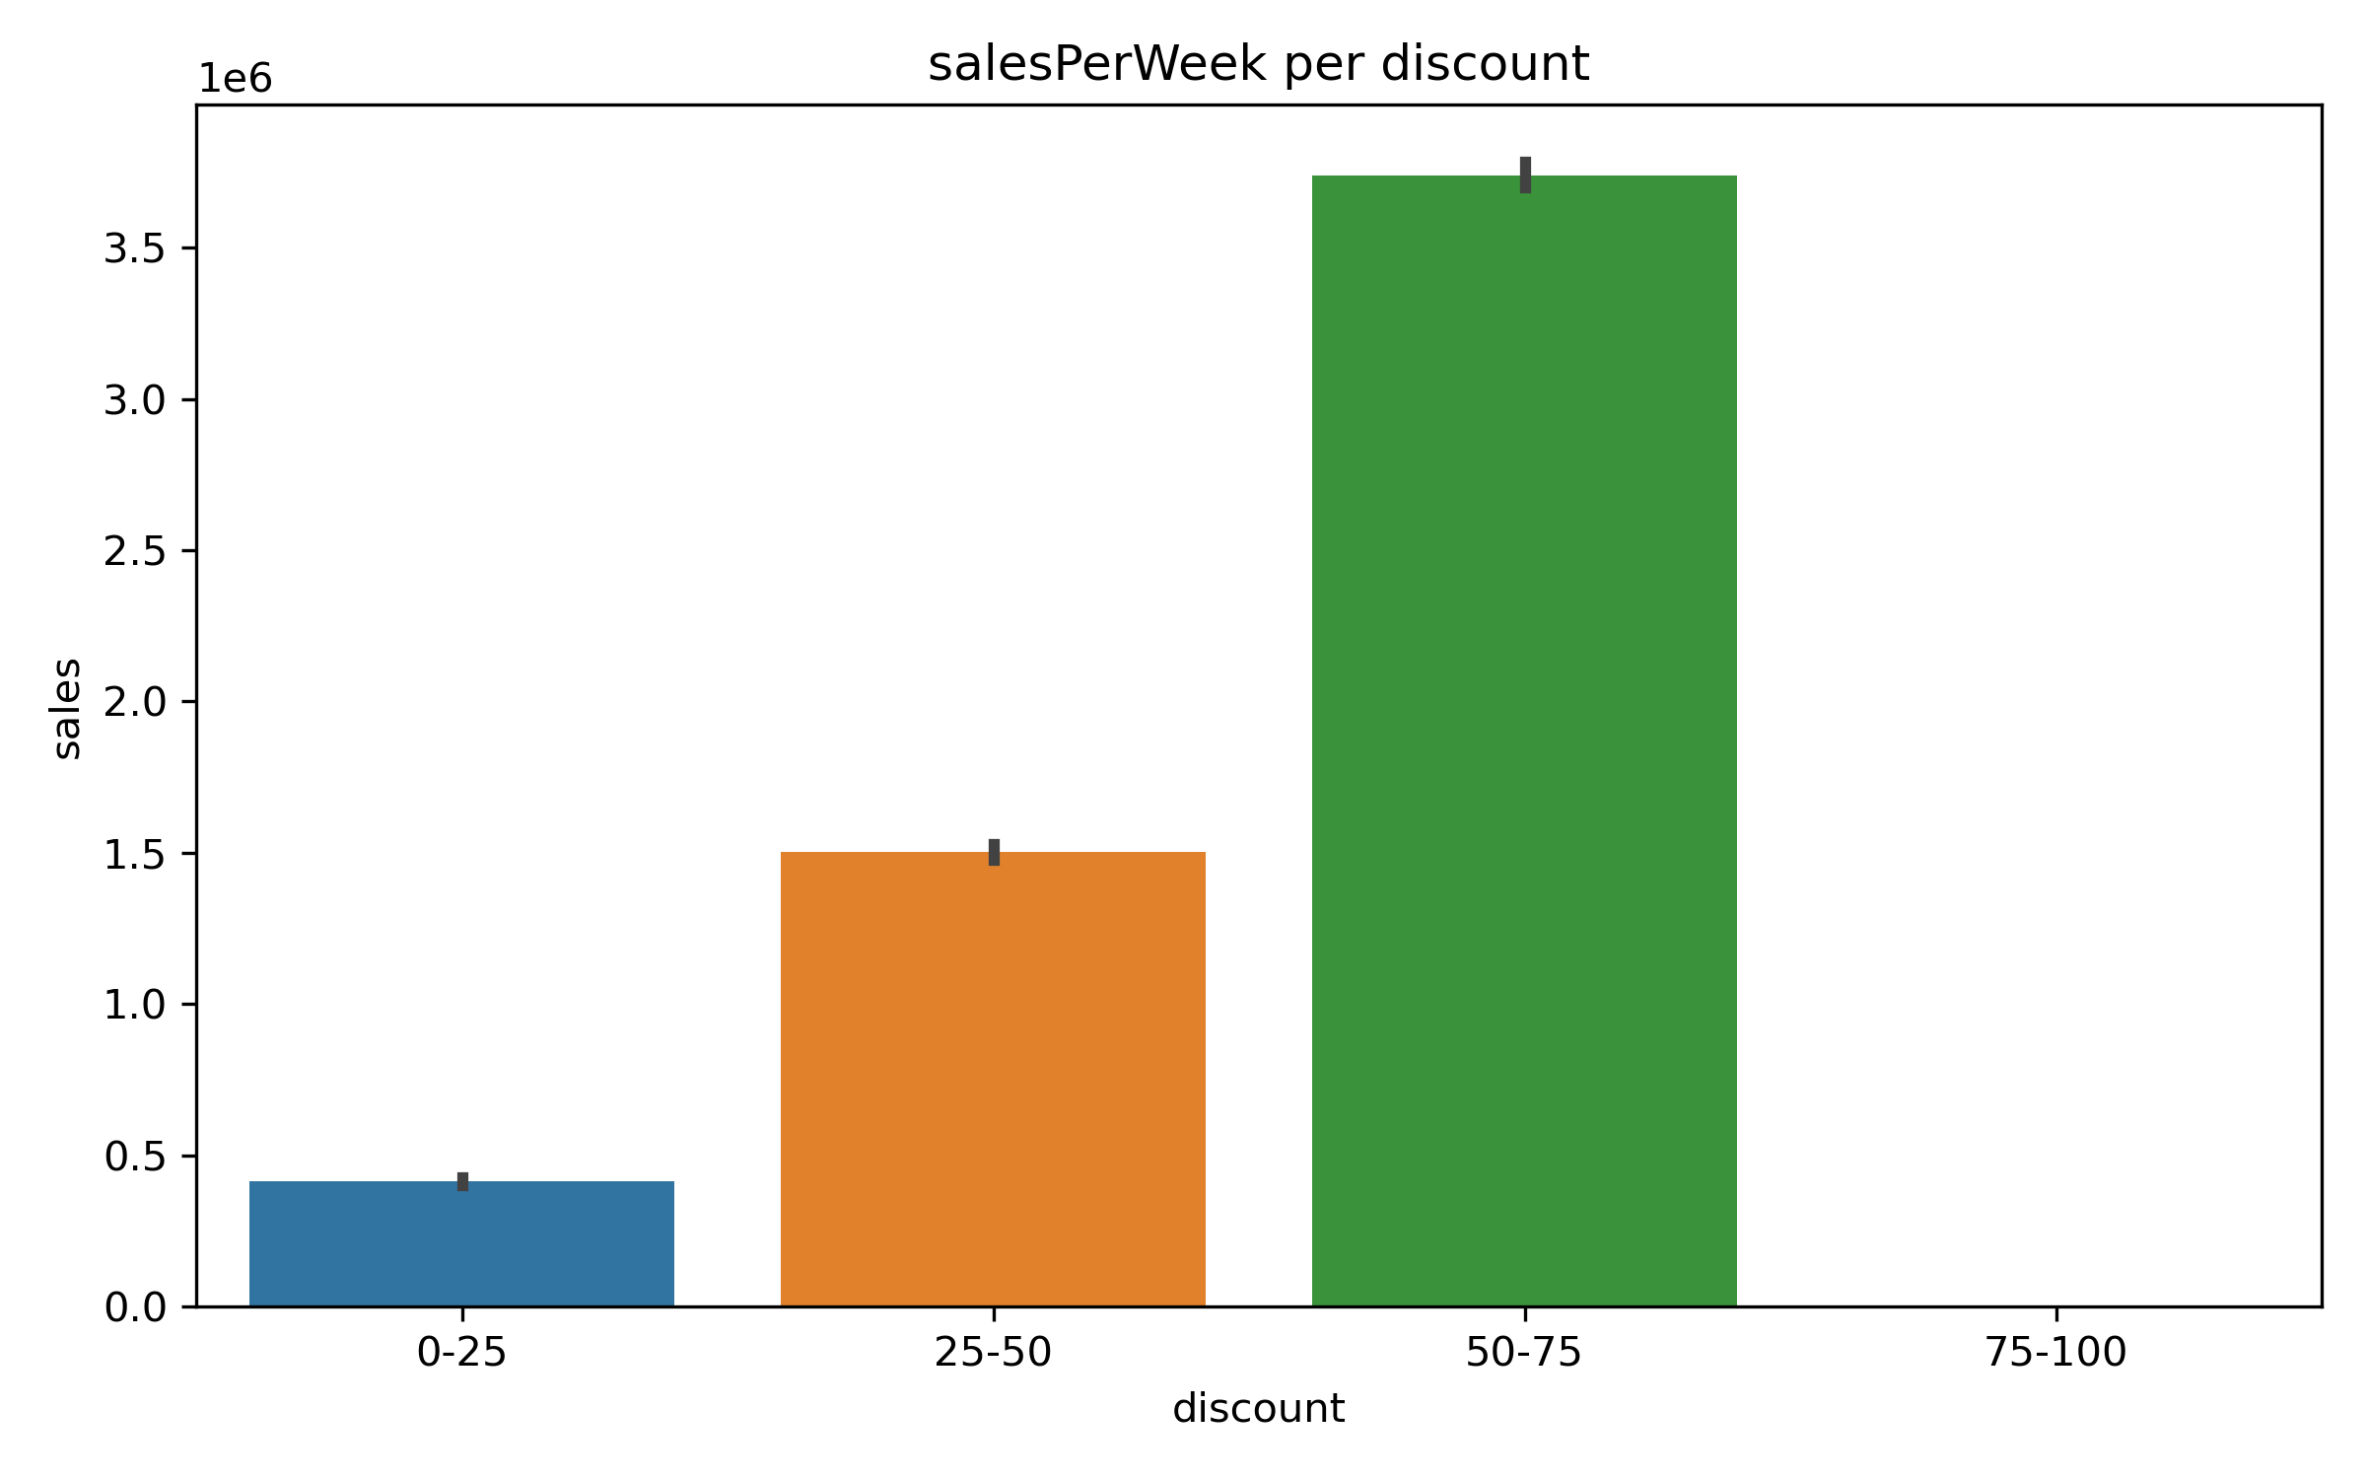
Advanced Analytics
Conclusion:
The number of sales increases with higher discounts on products
January 2, 2024

Slide 17
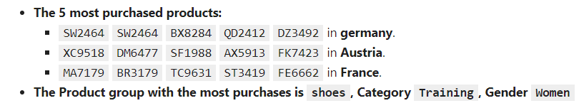
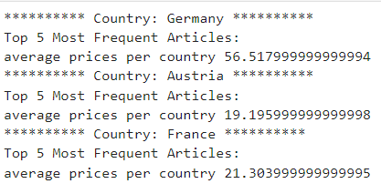
Advanced Analytics
Conclusion:
Customers in Germany can pay prices that are approximately twice as expensive as those in France and Austria.
We can increase purchases in both Austria and France by offering products at lower price.
January 2, 2024

Slide 18
Recommendations
Based on previous findings:
- If the company wants to increase its sales in low selling months, then It is recommended that the company focuses its campaigns and promotions during the months with the lowest number of sales to push these months sales higher.
- However, If the company want to increase the sales of during holiday seasons like Christmas and summer, valentine’s day and black November, then the company should focus its campaign during these months.
- Also, It is better to media campaigns before the season start within a month, to ensure the campaign is effective.
- Focus on Store events instead of media advertisements in France and try push store events into Germany and Austria to see how well it will do there.
- We can increase purchases in both Austria and France by offering products at lower price, Customers are purchasing products with low prices compared to customers in Germany.
January 2, 2024

Slide 19
Data Science Process
January 2, 2024

Slide 20
Pipeline
1- Frame the Business Problem
2- Data Understanding
3- Data preprocessing
4- Exploratory Data Analysis
5- Feature Engineering
6- Model Building
January 2, 2024

Slide 21
Frame The business problem
Get overview of the Business
Business Objective
Current Solution
Frame the problem (supervised Binary Classification task, Imbalanced)
Performance Measure to be used
January 2, 2024

Slide 22
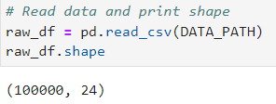
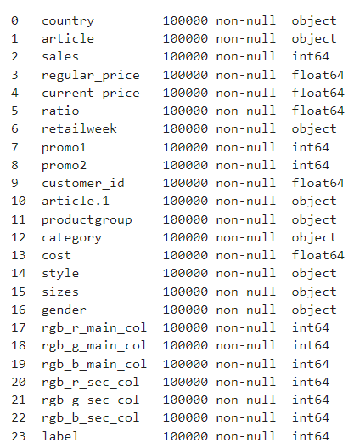
Data Understanding
The Dataset covers weekly sales happened from 28 Dec 2014 to 30 April 2017
We are dealing with Imbalnced Dataset since, 13.9% have labels of value 1.
The Dataset consists of 100000 rows and 24 columns, With no missing values and no duplicates.
The Dataset covers only 3 Countries Germany, France, Austria.
The Dataset covers weekly sales happened from 28 Dec 2014 to 30 April 2017
We are dealing with Imbalanced Dataset since, 13.9% have labels of value 1.
January 2, 2024

Slide 23
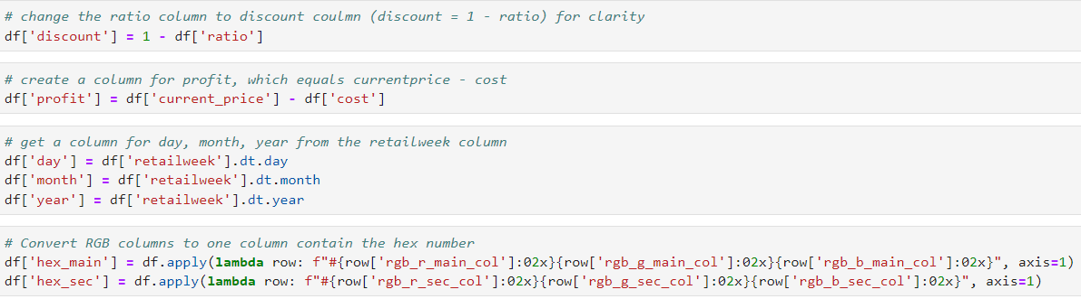
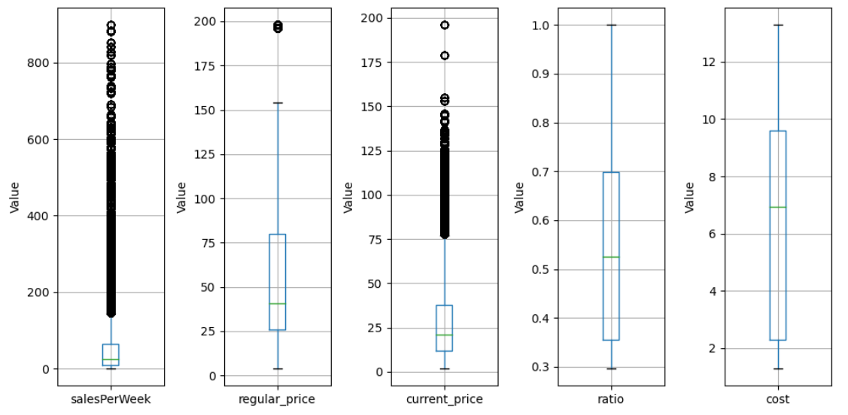
Data Preprocessing
1- Data Cleaning
- Check for outliers and deal with them
- Check for missing values( No missing values)
2- Create new features
January 2, 2024

Slide 24
Exploratory Data Analysis
Derive useful visualization:
- Correlation matrix
- pie plot, bar plot, histograms
- Time series analysis
- Explore the numerical attributes distributions
January 2, 2024

Slide 25
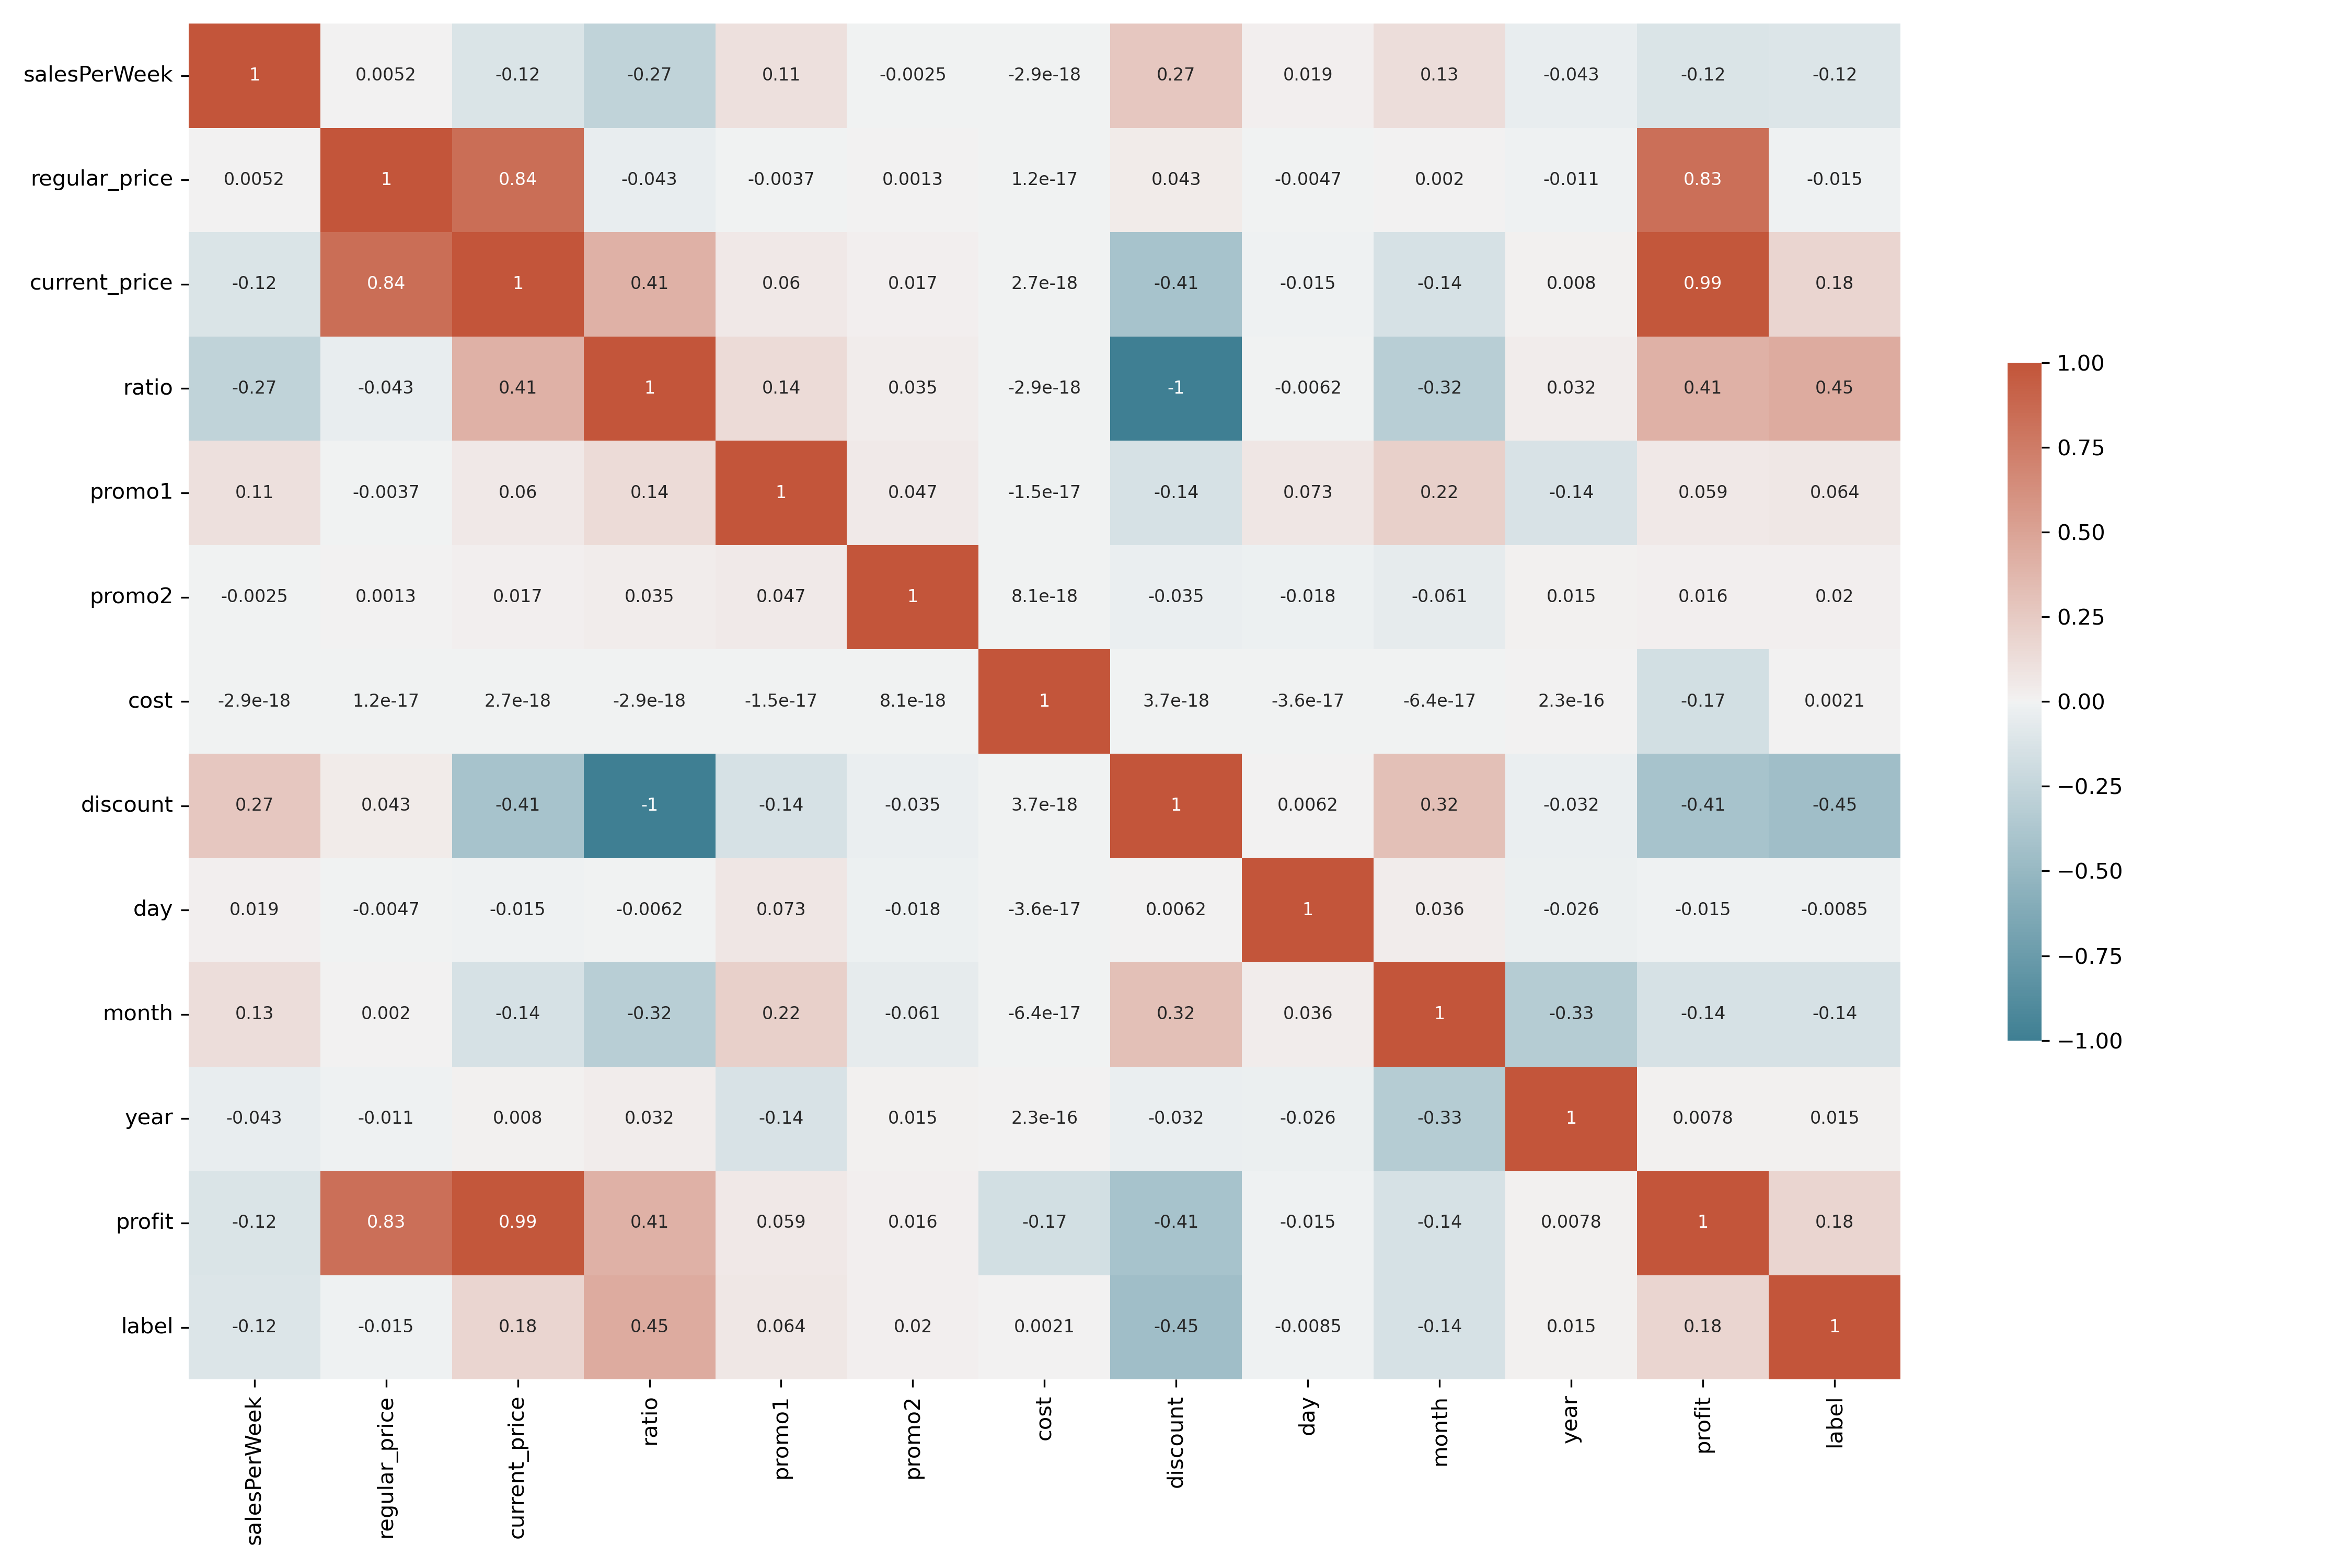
Exploratory Data Analysis
Correlation matrix:
- salesPerWeak: has a small positive correlation with discount column.
- regular_prices, current_prices and profit columns have a highly positive correlation
- discount has a negative correlation with profit
- discount has a positive correlation with month.
- The label column:
- Has a negative correlation with discount - has a small negative correlation with sales and a small positive correlation with current_price
January 2, 2024

Slide 26
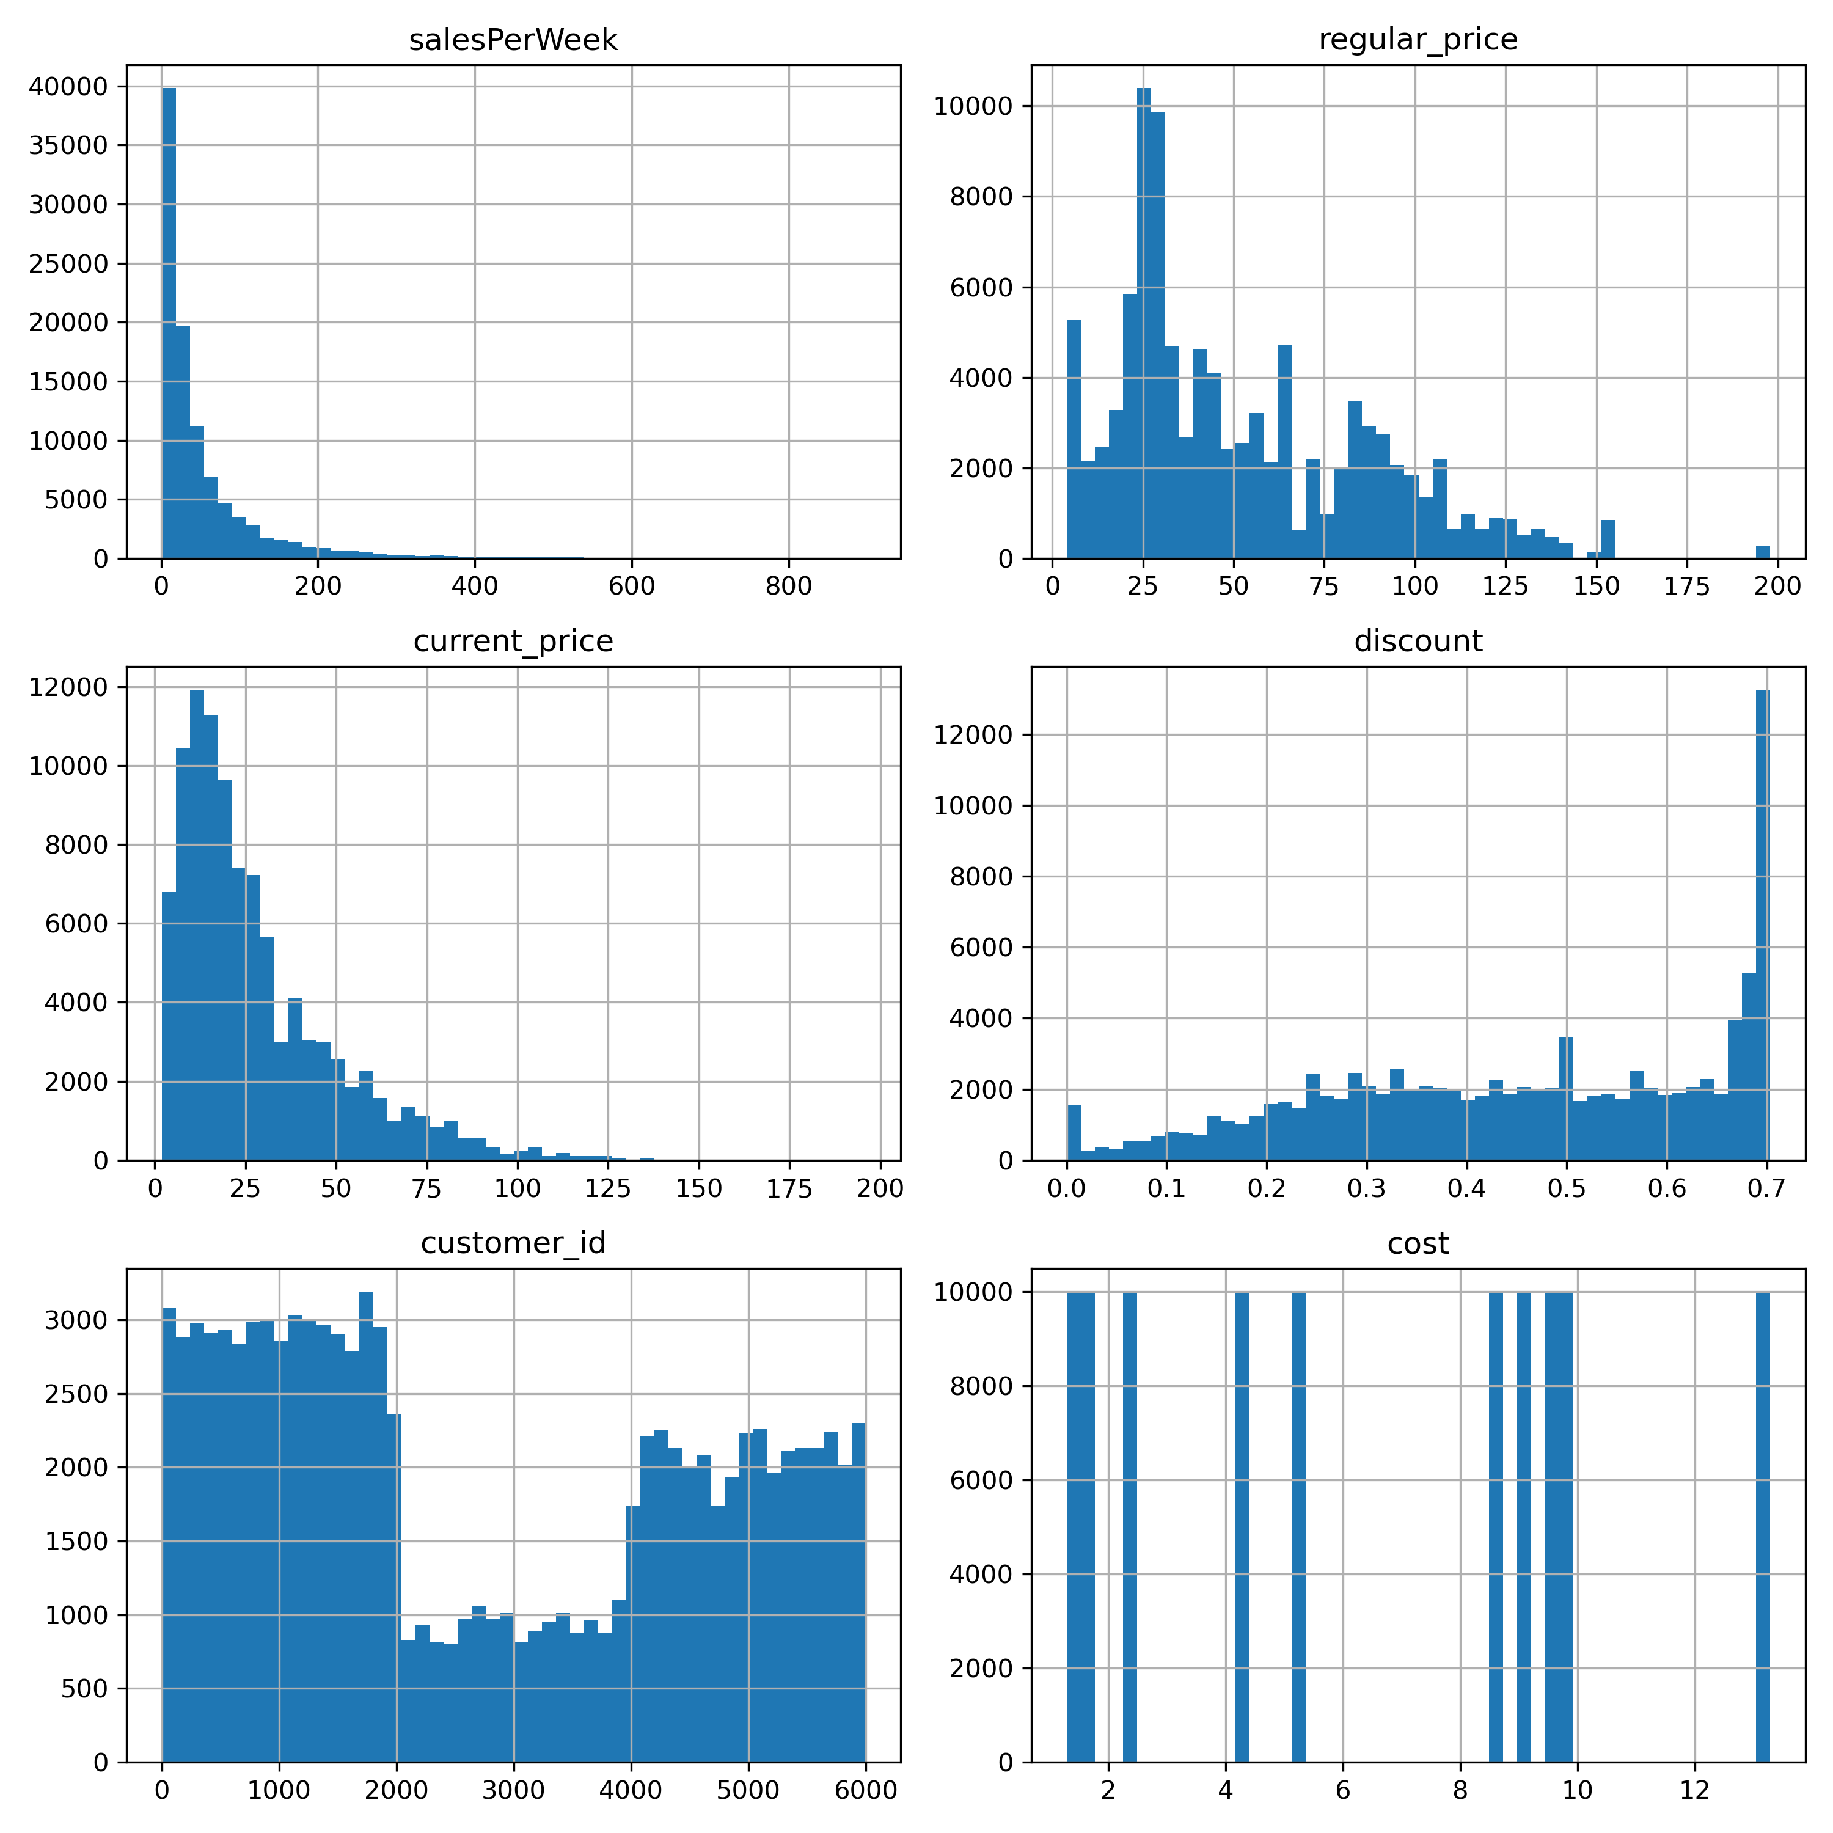
Exploratory Data Analysis
Explore Numerical Columns:
- The 3 columns salesPerWeek, regular_prices, current_prices have a heavy tailed distribution, it might be helpful to take the log of values, to make it look more gaussian before we feature scale it.
- customer_id doesn't seem to have any value, so it is better to not use it.
January 2, 2024

Slide 27
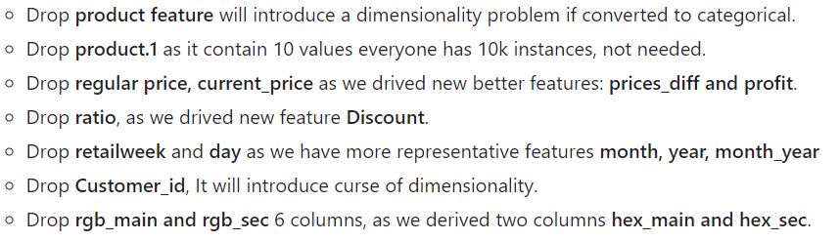
Feature Engineering
1 – Create test set
before any step to avoid data leakage.
Used Stratified sampling.
2 – Apply Feature Selection
3 – Handling categorical attributes
Apply One-Hot Encoding.
4 – Apply Feature Scaling
Standardize numerical features.
January 2, 2024

Slide 28
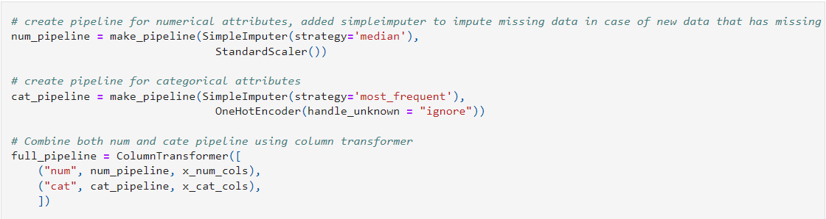
Model building
1 - Build Transformation pipeline
2 - Select and train a certain model
Logistic Regression
Random Forest
K-Nearest Neighbors
3 - Evaluate the models
K-fold cross-validation
4 - Handling Imbalanced Dataset
Try SMOTE over sampling
Try Random over sampling
440 2426
January 2, 2024

Slide 29
Model building
4 – Fine Tuning the best models
Using Grid Search
5 – Try Ensemble Learning
Voting Classifier(soft)
Gradient Boosting(Xgboost)
6 – Analyze the Best Models and their Errors
Using Random Forest feature_importances
440 2426
January 2, 2024

Slide 30
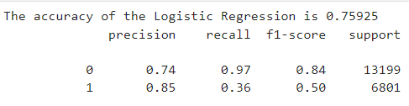
Model building
Confusion Matrix
6 – Evaluate your system on the test set
7 – Import the best model
True Negatives(TN): 12759
True Positives(TP): 2426
False Negatives(FN): 440
False Positives(FP): 4375
12759 4375
440 2426
January 2, 2024

Slide 31
Things To try next
1 – Exploratory Data Analysis
- Convert RGB columns to colors and figure out if there is a correlation between purchases and colors
- Use unsupervised visualization techniques to identify clusters in the data.
- Use Time-series Analysis
440 2426
January 2, 2024

Slide 32
Things To try next
2 – Feature Engineering
- Take the logarithm of Heavy Tailed distribution attributes before scaling.
- Try RobustScaler with Heavy Tailed attributes.
- Encode style column to ordinal encoder
440 2426
January 2, 2024

Slide 33
Things To try next
3 – Model Building
- Try Random over sampling and compare it with Smote over sampling
- Try different ensemble methods like voting classifier or gradient boosting
- Try PCA with the best model
- Analyze the best models and their errors
- using feature importance's to identify useless features , remove them and retrain the model.
440 2426
January 2, 2024

Slide 34
Things To try next
3 – Finally
- Write Function for the whole data transformations we applied, to easily clean and prepare any new data instances:
- Feature Pipeline
- Training Pipeline
- Inference Pipeline
- Refactor the code into proper scripts, instead of notebooks .
- Build an API to receive data and predict the outcome.
440 2426
January 2, 2024

Slide 35

Thank you
Email:
AlyAbdelhamied@gmail.com

